Slide 1



HUMAN RESOURCE MANAGEMENT
BUS 102

Slide 2
WHAT IS HRM ?
⑨Human Resource Management (HRM) is an operation/function in companies
Designed to 🖲Maximize employees’ performance
🖲Why?
🖲In order to meet the employer's strategic goals and objectives
🖲How HR can maximize employees’ performance?
🖲HRM focuses on management of people within companies, emphasizing on policies and systems.
🖲What are the processes of managing these people within the
organization?
🖲It is the process of determining HR needs, acquiring
(recruiting & selecting), training(motivating), appraising (rewarding, evaluating), compensating, scheduling employees and Focusing on labor relations, health and safety, fairness concerns
🖲Why?
🖲 So that HR can maintain competent workforce
🖲Why to maintain a competent workforce?
🖲To achieve the goals of an organization in an effective and efficient manner.

Slide 3
People: The Ultimate Resource
There has been a shift from manufacturing to service industries, and also to high-tech manufacturing.
Businesses are adopting AI-driven tools (e.g., in production, data analysis, customer service)
Digitally literate (having the ability to use digital tools effectively) workers are in high demand
Remote work has become more widespread, making digital proficiency essential. Many companies are offering flexible work from home opportunities.
It’s HR’s responsibility to recruit digitally literate talent and train current employees in modern digital tools.

Slide 4
People: The Ultimate Resource
Nowadays, because of increased competition, good, qualified employees are much harder to find. So, HR is now much more challenging and important than before.
Remote work also increases competition and complexity in hiring.
The human resource job is now the job of all managers in an organization (Shared HR Responsibility)

Slide 5
SOME MAJOR HR CHALLENGES
▶ Cost (Health care, Training, Hiring process)
▶ Skilled Workers: A shortage of trained workers in important, growth areas (such as IT, Green Technology etc)
▶ Technology (large database): Overabundance of workers in declining industries, such as steel and automobiles (who need retraining)
▶ Economy (Nation’s Unemployment problem): Increased outsourcing (jobs going abroad), because labour costs in other countries are much cheaper
▶ Changing and Diverse Workforce: Increasing single-parent families, and therefore the need for maternity leave, job sharing, telecommuting etc increases. HR has to balance these needs against organizational profitability
▶ Ethics: A decreased sense of employee loyalty (due to so many firms in the market, shorter job cycles, contractual work etc.)

Slide 6
ROLES OF AN HRM MANAGER
▶ Developing & Implementing Staffing plan (Recruitment & Selection)
▶ Developing Workplace Policies
▶ Compensating the employees
▶ Making Retention Policies
▶ Providing Training and Development
▶ Dealing with Laws , Regulations………affecting Employment
▶ Providing Worker Protection
▶ Establishing Communication
▶ Creating Awareness about External Factors

Slide 7





















HRM FUNCTIONS (SPECS-ME-CTR)
Human Resource Managem
Career Manage ment
Recruit ment
ent
Selectio n
Employe
e Union
Relation s
Talent management/
Organizati onal Goals
Equal employment opportunity
Scheduli
ng
Training And
Develop ment
Compen sation and Benefit
Perform ance
Evaluati on
Motivati on
Copyright © 2010 by The McGraw-Hill Companies, Inc. All rights reserved.

Slide 8
RECRUITMENT AND SELECTION
▶ During Recruitment and selection, the line manager describes the qualifications employees need to fill specific positions.
▶ Then the human resource team (Staff) takes over.
▶ HR managers sort qualified applicants, conduct initial screening interviews, administer the appropriate tests and then refer the best applicants to the line manager, who interviews and selects the ones he or she wants.

Slide 9
RECRUITMENT
Recruitment is the set of activities used to obtain a sufficient number of the right employees at the right time.
Recruiting is not an easy task. On the contrary, it become very challenging for several reasons:
Retaining employees is a challenge
It is important to hire people who are not only skilled but also fit in with the culture and leadership style of the company
Sometimes people with necessary skills are not available; then
workers must be hired and trained internally

Slide 10
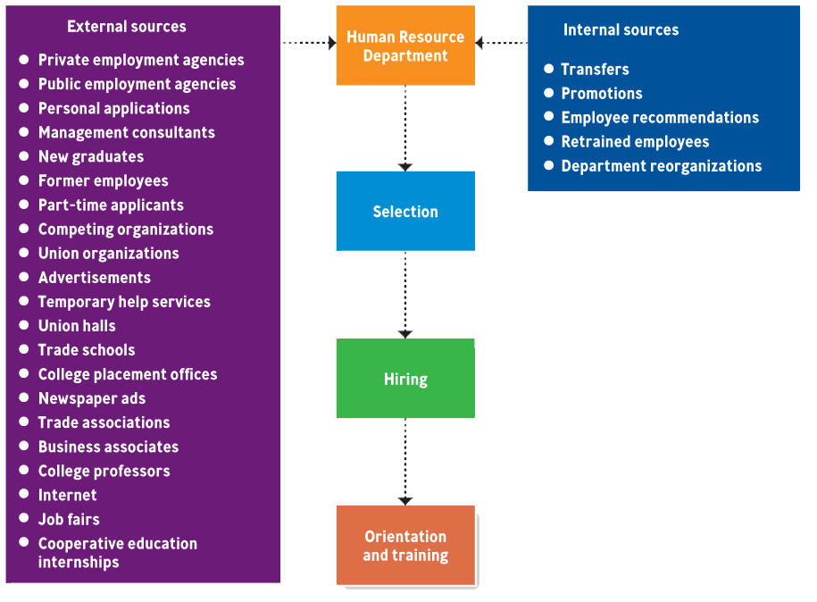
Employee Sources

Slide 11

SELECTION
▶ The process of gathering information and deciding who should be hired, under legal guidelines, to fit the needs of the organization and individuals.
▶ Selection & training are extremely expensive
process.
SELECTION PROCESSES
Step 1.Obtaining complete application forms Step 2.Conducting initial and follow up interviews Step 3. Giving employment tests
Step 4. Conducting background investigations Step 5. Obtaining results from physical exams Step 6. Establishing trial (probationary) periods

Slide 12
Using AI in Recruitment
Companies are using Artificial Intelligence to improve and automate parts of the recruitment process. Here are some key techniques:
▶ Resume Screening: AI scans and filters resumes based on job criteria (skills, experience, keywords).
▶ Chatbots: Conversational AI that interacts with candidates, answers questions, and screens them.
▶ Video Interview Analysis: AI analyzes video interviews for tone, language, and facial expressions to assess soft skills and fit.
▶ Game-based assessment: Uses AI-based games to assess personality, behavior, and cultural fit.

Slide 13
COMPENSATION
Compensation refers to the total payment and benefits an employee receives in exchange for their work.
The objectives of compensation policy are as follows −
▶ Attract suitable staff and keep qualified personnel.
▶ Develop reward structures that are equitable with logical and fair pay relationships between differently valued jobs.
▶ Manage pay structures to mirror inflationary effects.
▶ Assure that rewards and salary costs handle changes in market rates or organizational change.
▶ Appraise performance, duty, and loyalty, and provide for progression.
▶ Abide by legal requirements.
▶ Maintain compensation levels and differentials under review and control salary or wage costs.

Slide 14
Types of Compensations
When it comes to an organization, be it private or public, compensations are further divided into the following −
Direct Compensation
▶ It is naturally made up of salary payments and health benefits. The creation of salary ranges and pay scales for different positions within an organization are the central responsibility of compensation management staff.
▶ Direct compensation that is in line with the industry standards facilitates employees with the assurance that they are getting paid fairly. This helps the employer not to worry about the costly loss of trained staff to a competitor.
Indirect Compensation
▶ It focuses on the personal encouragement of each individual to work.
Although salary is essential, people are most productive in jobs where they share the company's values and priorities.
▶ These benefits can include things like free staff development courses, subsidized day care, the chances for promotion or transfer within the company, public recognition, the ability to effect change or bring some changes in the workplace, and service to others.
▶ These are the two types of compensation that need to be managed and have its own contribution in the development of the organization. Moving forward, we will see the different components of compensation.

Slide 15
TYPES OF PAY
▶ Salary
▶ Hourly Wage/Day Work
▶ Piecework System
▶ Commission Plans
▶ Bonus Plans-monetary & cashless
▶ Profit Sharing Plans/Performance-based pay (annual)
▶ Gain-Sharing Plans (annual)
▶ Stock Options

Slide 16
TRAINING AND DEVELOPMENT
▶ In training, the line manager again describes what he or she expects the employee to be able to do. Then the human resource team (Staff) develops a training program, which the line manager then (usually) administers.
▶ Again, Without cooperating each other this would difficult
▶ Training and Development -- All attempts to improve productivity by increasing an employee’s ability to perform.
▶ Training focuses on short-term skills.
▶ Development focuses on long-term abilities.
▶ Both include 3 steps:
Assessing organization needs and employee skills to determine training needs;
Designing training activities to meet identified needs;
Evaluating the training effectiveness.

Slide 17
TRAINING AND DEVELOPMENT METHODS
▶ Orientation
▶ On-the-Job Training
▶ Apprentice Programs
▶ Off-the-Job Training
▶ Vestibule Training

Slide 18
Training methods to enhance employees’ digital skills
Some training methods to develop and strengthen employees' digital skills within an organization-
▶ E-learning: Delivered via digital platforms - Flexible, cost-effective, and scalable (virtual sessions, Coursera)
▶ Simulations & Virtual Labs: Safe, realistic environments to practice using software or tools without real-world risk.
▶ Workshops: Interactive sessions led by experts to learn digital tools/software (Microsoft 365, Data analysis and visualization, AI).

Slide 19
DEVELOPING EFFECTIVE MANAGERS
▶ Management Development -- The process of training and educating employees to become good managers and tracking the progress of their skills over time.
▶ Management training includes:
On-the-job coaching
Understudy positions
Job rotation
Off-the-job courses and training
▶ Networking –The process of establishing and maintaining contacts with key managers in & outside the organization and using those contacts to weave strong relationships that serve as informal development systems.
▶ Mentor—An experienced employee who supervises, coaches and guides lower- level employees by introducing them to the right people and generally being their organizational sponsor.
▶ Diversity-- Emphasizes on grooming women and minorities for management positions.

Slide 20
PERFORMANCE APPRAISAL
PERFORMANCE APPRAISAL is an evaluation in which the performance level of employees is measured against established standards to make decisions about promotions, compensation, additional training, or firing.
Almost all workers undergo a performance appraisal annually at large corporations.
In the 360-degree review, management gathers opinions from all around the employees in order to get a comprehensive idea of the worker’s abilities.

Slide 21
ETHICAL HRM – 6 guidelines for HR Teams
1) Know the laws
2) Prioritize professional development
3) Be an ethical HR leader
▶ Commitment: “The desire to do the right thing regardless of the cost.”
▶ Consciousness: “The awareness to act consistently and apply moral convictions to daily behavior.”
▶ Competency: “The ability to collect and evaluate information, develop alternatives and foresee potential consequences and risks.”
4) Understand conflicts of interest
5) Implement diversity and inclusion practices
6) Keep information confidential

Slide 22


